Slide 1


SAP S/4HANA Training
MASTER DATA GOVERNANCE (SAP MDG)
Neeraj Gupta

Slide 2

INTRODUCTION

Slide 3
1. SAP MDG Training Objectives & Agenda: Training Objectives
I
SAP MDG Overview: Conduct a general overview training on SAP MDG for business users and master data steward’s with key focus on implementation considerations for managing Master data in various domains.
SAP MDG Workshop: To build a detailed understanding of the new features offered by SAP MDG in 9.0/9.2 vis-à-vis previous versions and how to build the custom solutions using custom data models.
SAP MDG: Knowledge transfer and exercises throughout the training to ensure that towards the end of the program, the participants are well versed with the standard SAP MDG processes and its settings.

Slide 4

SAP MDG Training Objectives & Agenda: Trainer’s profile in nutshell
I
Neeraj has experience of 22+ experience in SAP consulting. He has worked as solution architect in water utilities for clean and wastewater businesses in areas of asset management, Data Management, work force management and project systems.
Education
SAP certified Consultant
B.Tech. (Electronics).
Experiences
Projects
SAP PLM/ S4HANA certified consultant on global ERP implementation and landscape transformations
Experience in solution, Customization and configuration in SAP S/4HANA Enterprise Management, SAP MDG, SAP ECC, SAP R/3.
Solution design for SAP MDG 8.0 and MDG 9.2 for CODs for defense sector.
Handled 85+ trainings in SAP S4HANA PP, QM, SAP ISU, SAP DM & Billing/ Invoicing, SAP PM, PS, DMS, SAP MM, Solution Manager (7.1/7.2) and MDG at authorized training centers and with corporates. As corporate freelance consultant and trainer delivered assignments to Consulting and end user customers.
Solution Architect for building enterprise services for AMI – MDUS smart metering for a global energy company. Building Automated test cases for testing using eCATT and Solution manager 7.1
Implementing SOLMAN 7.2 ITSM, CHaRM, Service management, SOLDOC, BPH, MAI, SLR, KPI and dashboards.
Technology system integrator (Noida)
Solution Architect
AMI- interfaces to Energy IP
Water Utilities (UK)
Solution Architect: (Work force management, MDM)
Automobiles (Noida)
Implementing S/4HANA EM E2E.
Oil Major (Abu Dhabi)
SAP PP, PM & Quality management implementation
Pharmaceuticals (US & Mumbai)
SAP MDM and SAP UI5 application development
Beverages (EU – Denmark)
SAP PM, QM & MM Roll-out implementation
Manufacturing Industries (Delhi)
Implementing MDG functions as roll-out project
Power Utilities (UK & India)
Implementing WCM and PM functions in ECC 6.0
SAP Freelance Consultant
Prozia management Consulting Pvt. Ltd (Noida, Canada and Dubai)
Industries
Utilities
Manufacturing
FMCG
Automobile
Certifications / Training
85+ trainings
SAP PLM/ WM/ MDG
SAP S4HANA Logistics
SAP Activate
SAP Solution Manager
Major Accomplishments
Successful deployment of S/4HANA 1709/ 1803 system in automobile & Utilities industry
Automated test cases for AMI smart metering infrastructure
Building bi-directional adaptor with EPM (Enterprise Project Management) for project management reporting
Building 100% customized solution for clean water business – workforce management and integration with SAP CRM using e-Forms
Languages
Hindi
English

Slide 5
1. SAP MDG Training Objectives & Agenda: Training schedule
I
Day 1
Lesson 1 – Overview of Enterprise Information Management
Lesson 2 - Introduction to Master Data Governance
Day 2
Lesson 3 - MDG Architecture
Lesson 4 – MDG Data Domains & Deployment
Day 3
Lesson 5 – Data Modelling
Lesson 6 – Configurations, standard & extended models
Day 4
Lesson 7 – Hierarchies & relationships
Lesson 8 - Standard & Custom Data Models
Day 5
(Exercises)
Lesson 9 - Data Model – extensibility use cases
Day 6
Lesson 9 – UI Modelling
Lesson 10 – Customization, CBA
Day 7
Lesson 11 – Process Modelling
Day 8
Lesson 12 - Governance scope, Change Requests
Lesson 13 – Workflow process modelling
Day 9
Lesson 14 – Using Rule Based Workflows
Day 10
Lesson 15 – Exercises using Business activities for Data
Lesson 16 – Data Quality & Search

Slide 6

Lesson 1
Overview of Enterprise Information Management

Slide 7
Categories of EIM Sophistication
1
Lesson 1: Overview of Enterprise Information Management
Level 5:
Chief data officer manages
corporate assets and identifies
ways to Monetize data assets
Level 4:
Data organizations ensures
SLA related to information
maintenance
Strategic
Goal
Level 3:
Data stewards ensures
Data quality across domains
Proactive
Proactive
Monitoring
Monitoring
Monitoring
Value
Level 2:
Issue resolution is
Possible with IT support
Reactive
Reactive
Reactive
Reactive
Level 1:
Understands what
Data assets you have
Recognition
Recognition
Recognition
Recognition
Recognition
People and process maturity

Slide 8
Business Benefits & Drivers for EIM Program
1
Lesson 1: Overview of Enterprise Information Management
Improved operational
Efficiency
. Business Processes
. Cost savings
. IT costs reduction
. Simpler IT landscape
. Cycle time for data creation
reduced
Increased regulatory
compliance
. Data privacy standards
. Blocking / archiving
. Safe working conditions
. Auditable governance processes
. Cycle time for data creation
reduced
. Accuracy & reliability
. Company’s image
. Customer satisfaction
Effective decision Making
. Informed decisions
. New markets
. Business transformation
initiatives
. New product management
. Social media feedback
. Corporate restructuring
. M&A
. Strategic divestitures

Slide 9
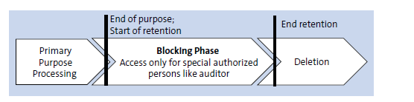
1
Lesson 1: Overview of Enterprise Information Management
Lifecycle of Personal data

Slide 10
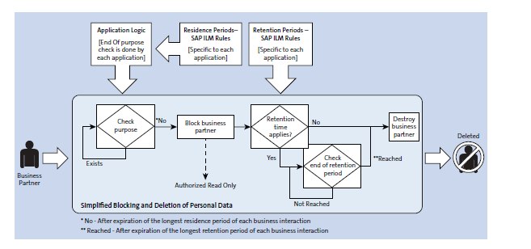
1
Lesson 1: Overview of Enterprise Information Management
End of Purpose (Blocking) process flow

Slide 11
1
Lesson 1: Overview of Enterprise Information Management
EIM Capabilities

Slide 12
1
Lesson 1: Overview of Enterprise Information Management
Master Data Consolidation

Slide 13
1
Lesson 1: Overview of Enterprise Information Management
Master Data Registry

Slide 14
1
Lesson 1: Overview of Enterprise Information Management
Central Master Data Management

Slide 15
1
Lesson 1: Overview of Enterprise Information Management
Hybrid or coexistence Central Master Data style

Slide 16
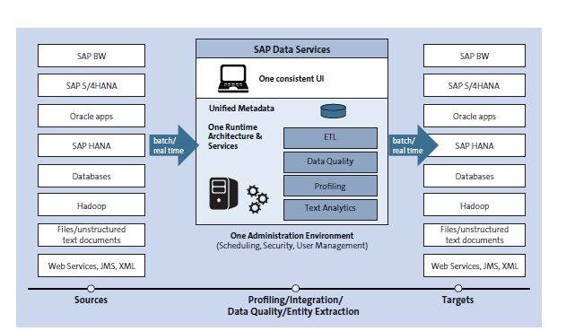
1
Lesson 1: Overview of Enterprise Information Management
SAP Data Services – Key capabilities

Slide 17
1
Lesson 1: Overview of Enterprise Information Management
SAP Information Steward – Key capabilities

Slide 18
1
Lesson 1: Overview of Enterprise Information Management
SAP HANA – Smart Data Integration and Smart Data Quality

Slide 19
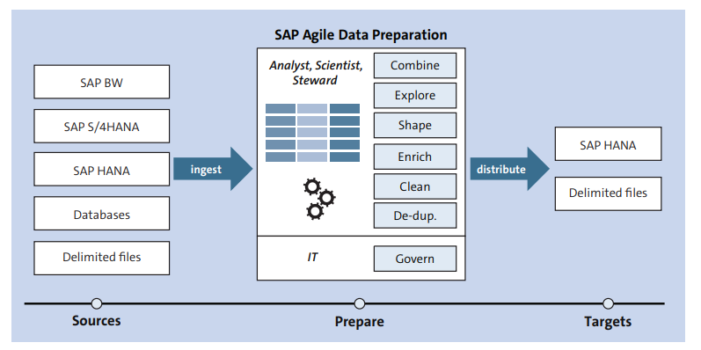
1
Lesson 1: Overview of Enterprise Information Management
SAP Agile Data Preparation: Key features

Slide 20
1
Lesson 1: Overview of Enterprise Information Management
SAP ILM Scenarios

Slide 21
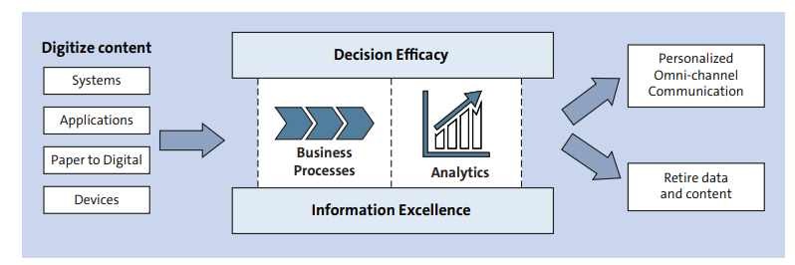
1
Lesson 1: Overview of Enterprise Information Management
SAP Content Management Solution: EIM Strategy component

Slide 22
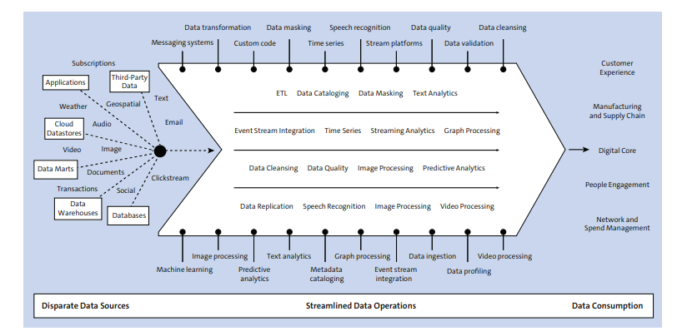
1
Lesson 1: Overview of Enterprise Information Management
SAP Data Hub: Features and capabilities

Slide 23
1
Lesson 1: Overview of Enterprise Information Management
SAP S/4HANA Cloud for Data Enrichment

Slide 24
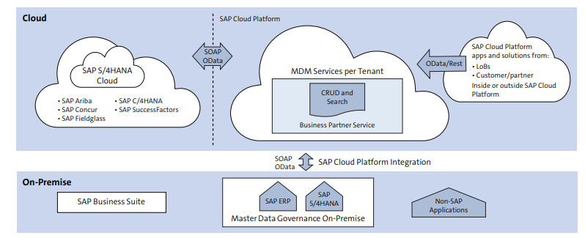
1
Lesson 1: Overview of Enterprise Information Management
SAP Cloud Platform Master Data for Business Partners : Integration

Slide 25
1
Lesson 1: Overview of Enterprise Information Management
SAP Data Quality Management: Microservices for Location Data

Slide 26
Lesson 2
SAP MDG – Introduction to Master Data Governance

Slide 27
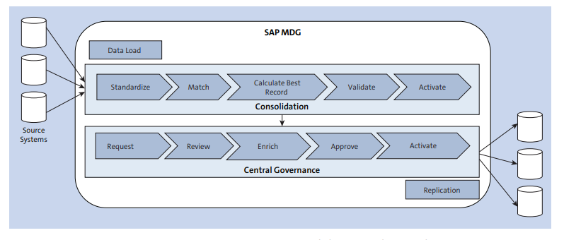
SAP MDG: Consolidation & Central Governance
2
SAP MDG – Introducing master data governance

Slide 28
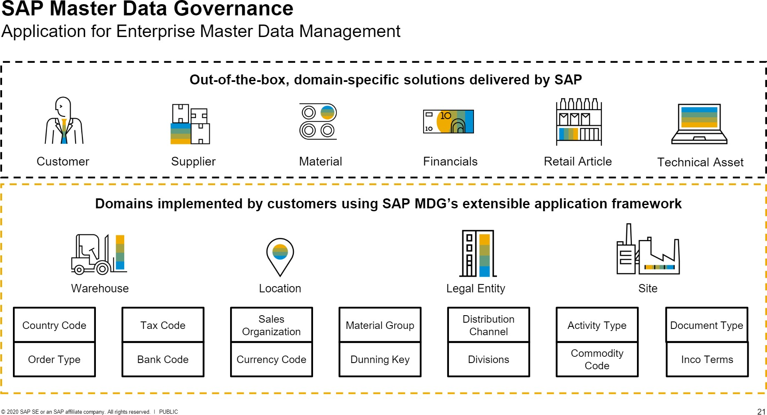
3
SAP MDG – Introducing master data governance

Slide 29
SAP MDG Use Cases: Central Governance
2
SAP MDG – Introducing master data governance
Audit Trails
Key mapping

Slide 30
SAP MDG Use Cases: Consolidation for analytics purposes only
2
SAP MDG – Introducing master data governance
Common Data Standards

Slide 31
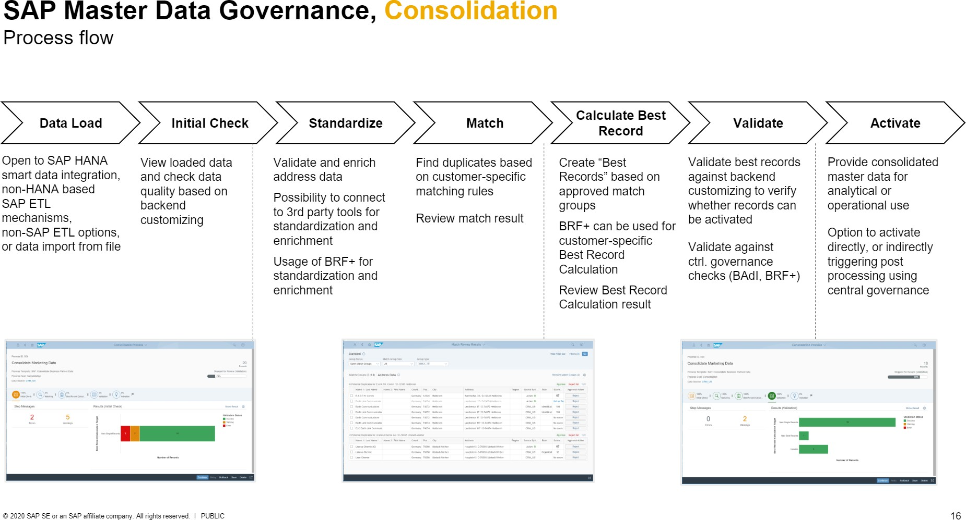
3
SAP MDG – Introducing master data governance

Slide 32
SAP MDG Use Cases: Consolidation for initial load before central governance
2
SAP MDG – Introducing master data governance
Extraction - Merged - Cleansed - Best record creation

Slide 33
2
SAP MDG – Introducing master data governance
SAP MDG Use Cases: Consolidation for mergers and acquisitions
Consolidation can be used to harmonize and de-duplicate the new data with the existing data
SAP MDG Use Cases: Continuous hybrid approaches

Slide 34
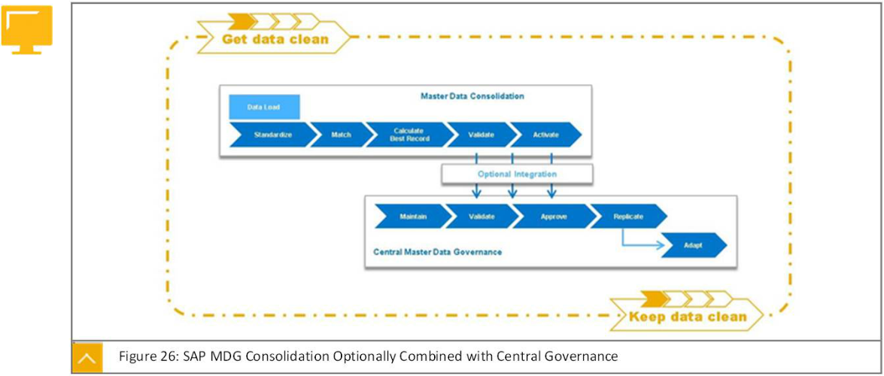
3
SAP MDG – Introducing master data governance

Slide 35
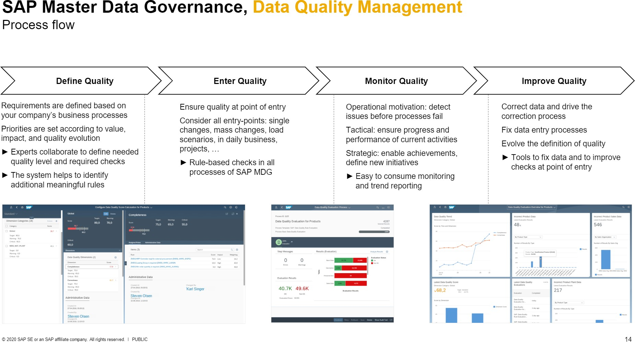
3
SAP MDG – Introducing master data governance

Slide 36
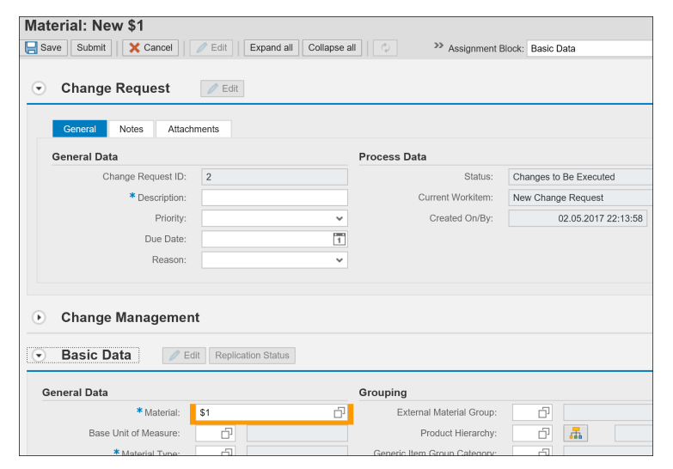
3
SAP MDG – Introducing master data governance
Floor Plan Manager example: Look and Feel

Slide 37
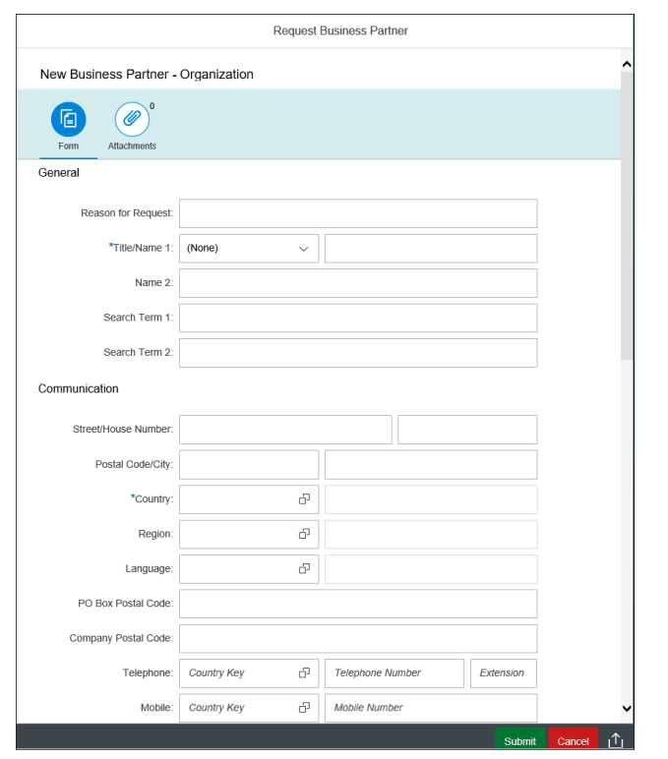
3
SAP MDG – Introducing master data governance
SAP Fiori example: Look and Feel

Slide 38
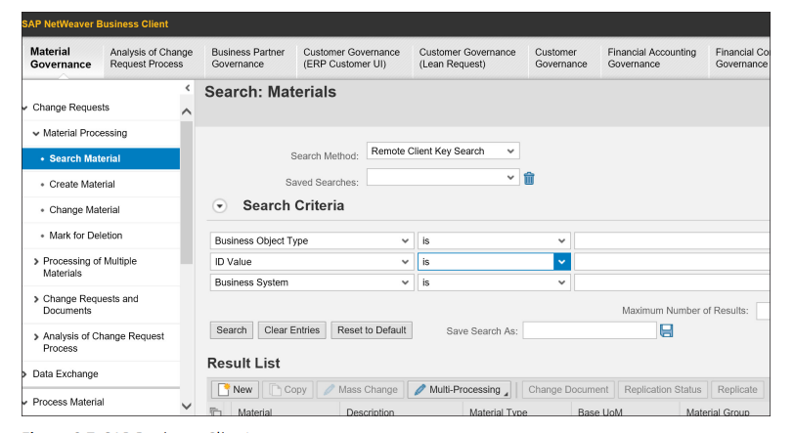
3
SAP MDG – Introducing master data governance
SAP Business Client example: Look and Feel

Slide 39
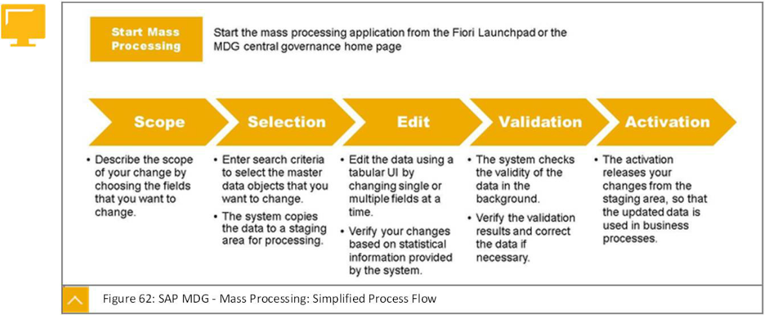
Mass processing
3
SAP MDG – Introducing master data governance

Slide 40
Lesson 3
SAP MDG – Architecture & Deployments

Slide 41
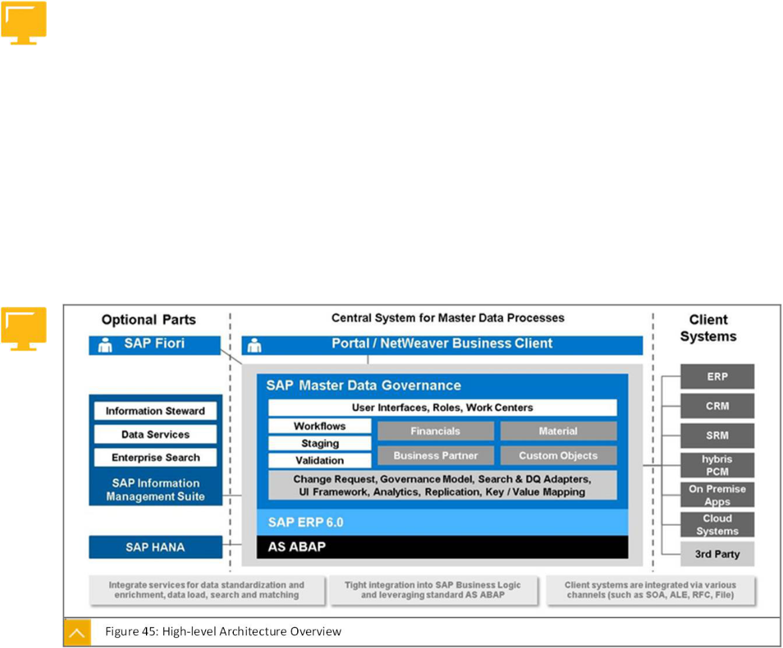
MDG Architecture
3
SAP MDG – Architecture & Deployment

Slide 42
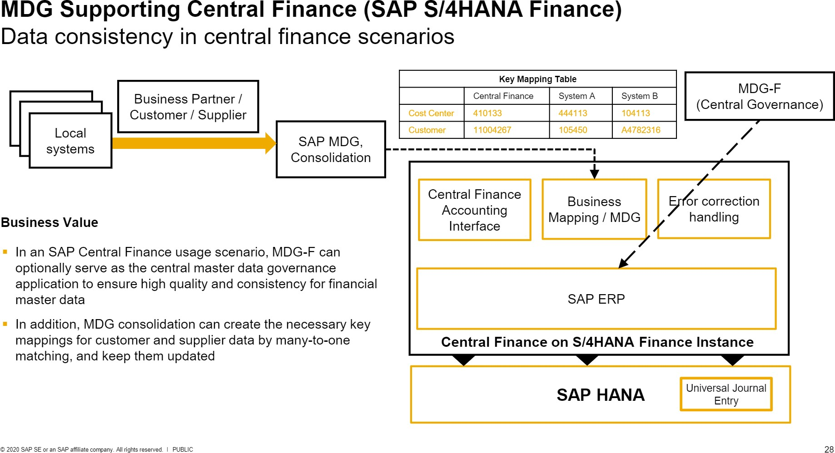
3
SAP MDG – Architecture & Deployment

Slide 43
3
SAP MDG – Architecture & Deployment
Hub approach vs Co-deployment approach
Customizing Synchronization
Reference Master Data Synchronization

Slide 44
3
SAP MDG – Architecture & Deployment
Hub approach vs Co-deployment approach (Customizing synchronization Approach)
1. Business configuration sets (BC Sets)
2. Customizing Transports (TMS Framework)
3. SAP Solution manager (Automated Option)
a. Customizing Distribution
b. Customizing Scout
c. XLD (Focused Build standalone extension (using workbench requests and Change Request Management)
4. ALE Customizing Distribution (Also for REF master data sync.)
5. System / client copy with customizing data (Restricted)
6. Choice of Database in ERP (ECC) system

Slide 45
3
SAP MDG – Architecture & Deployment
Hub approach vs Co-deployment approach (Customizing synchronization Approach)
Initial Synchronization
Ongoing synchronization
Semi-automatic synchronization
Custom solution
ALE-Based Customizing Distribution
SAP Solution Manager Based Customizing Distribution

Slide 46
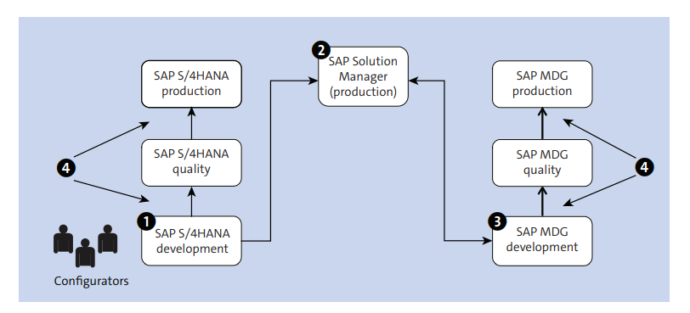
SAP solution manager based customizing process for ongoing synchronization
3
SAP MDG – Architecture & Deployment

Slide 47
3
SAP MDG – Architecture & Deployment
Customizing synchronizing setup

Slide 48
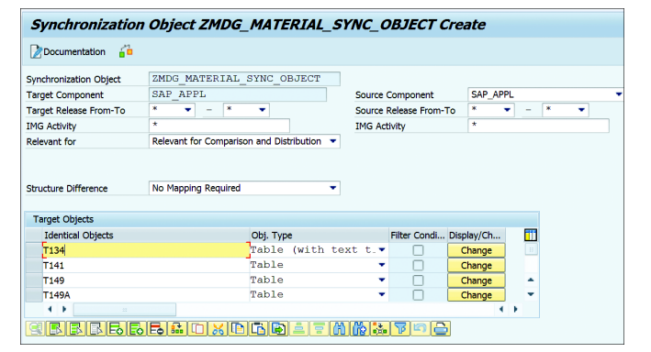
3
SAP MDG – Architecture & Deployment
Synchronizing Object creation

Slide 49
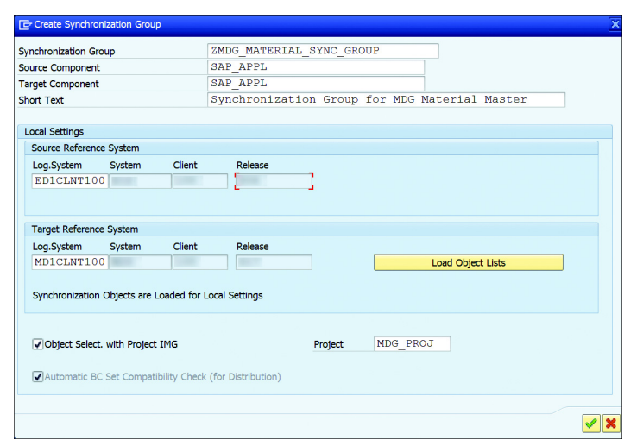
3
SAP MDG – Architecture & Deployment
Synchronizing Group creation

Slide 50
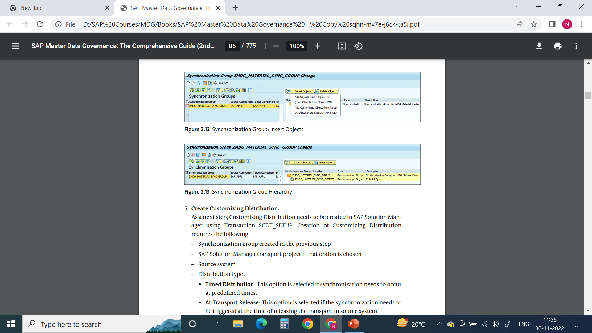

3
SAP MDG – Architecture & Deployment
Synchronizing Group : Insert Objects
Synchronizing Group Hierarchy

Slide 51
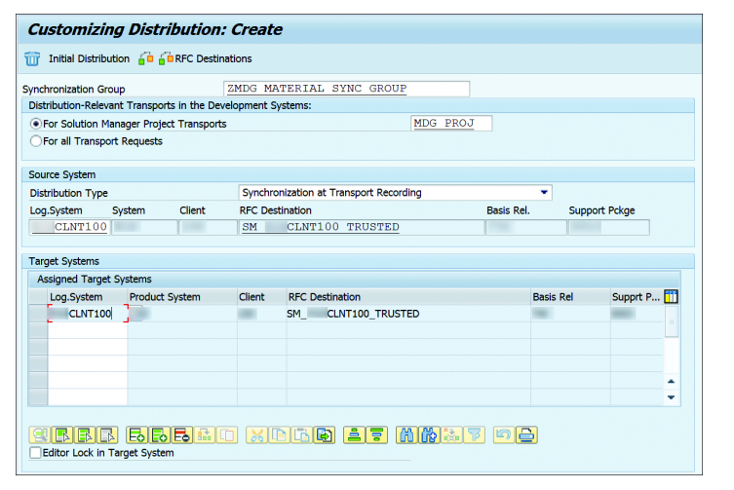
3
SAP MDG – Architecture & Deployment
Customizing Distribution

Slide 52
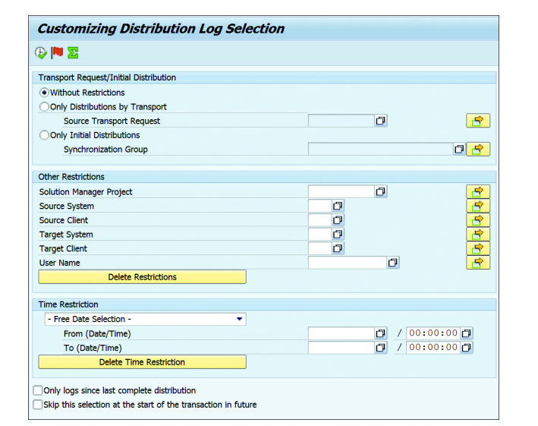
3
SAP MDG – Architecture & Deployment
Distribution Log: SCDT_LOG

Slide 53
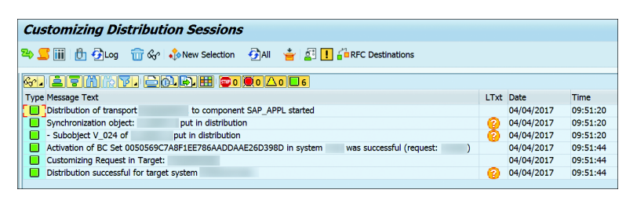
3
SAP MDG – Architecture & Deployment
Distribution Log example

Slide 54
3
SAP MDG – Architecture & Deployment
Customizing Scout

Slide 55
3
SAP MDG – Architecture & Deployment
Customizing Scout comparison based on synchronization group

Slide 56
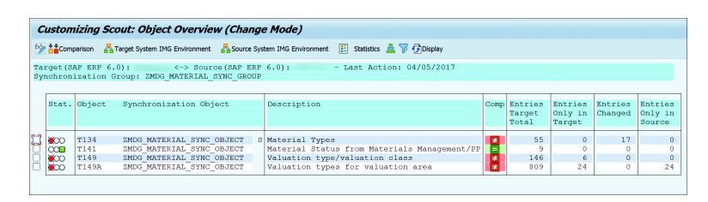
3
SAP MDG – Architecture & Deployment
Customizing Scout comparison result: example

Slide 57

End of Session 01

Slide 58

Questions

Slide 59

Neeraj gupta

Slide 60


We’re committed to empower you to be
Most Desirable Resource
through powerful training solutions.
We build the workforce of the future.
250+
Corporate Clients
30,000+
Learners Trained
25000+
Learners Placed
FREE WEBINARS
Sign up for free webinars with industry experts every fortnight!
Enroll Now!
Contact us today!
https://anubhavtrainings.com/

Slide 61




More from AnubhavTrainings.com

